Slide 1
Advance JavaScript
Notes:
Title - The learning outcome
Subtitle - Duration

Slide 2
In this section, we will discuss:
Introduction to events.
Introduction to exceptional handling.
BOM poperty and methods
setTimeout(), setInterval() method
Date methods
Introduction to Ajax
Intdoduction to JSON , JSON methods
Notes:
Mention the parent topics one by one. This particular learning outcome has 4 parent topics.

Slide 3
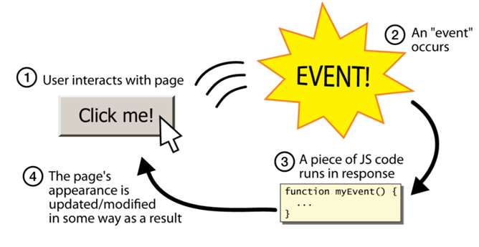
Introduction to Events, Events Handling
Events
JavaScript’s interaction with HTML is handled through events that occur when the user or the browser manipulates a page.
When the page loads, it is called an event.
Image Source:
Notes:
Left (White Color space):
Title - Parent Topic
Subtitle - Subtopic 1
Body Text - Description in bullets
Right (Grey Color Space):
Body Text - Relevant image (with source)/code snippet
Put reference links in Speaker Notes
Reference:
https://www.tutorialspoint.com/internet_technologies/internet_overview.htm/

Slide 4
Introduction to Events, Events Handling
Events continued..
Event-driven programming is when parts of the programming are executed in an unpredictable sequence in response to specific events.
Events are objects in JavaScript with case-sensitive names, all of which are lower-case.
Image Source:
Notes:
Left (White Color space):
Title - Parent Topic
Subtitle - Subtopic 1
Body Text - Description in bullets
Right (Grey Color Space):
Body Text - Relevant image (with source)/code snippet
Put reference links in Speaker Notes
Reference:
https://www.tutorialspoint.com/internet_technologies/internet_overview.htm/

Slide 5
Introduction to Events, Events Handling
Event Handling
Event Handling is the mechanism that controls the event and decides what should happen if an event occurs.
This mechanism has the code which is known as event handler that is executed when an event occurs.
Notes:
This slide talks about the case if we have to divide a subtopic further.
Title Box - Parent Topic
Subtitle box - Sub Topic
Body Text - Subtopic divisions (Subtopics of subtopics)

Slide 6
Introduction to Events, Events Handling
Event Handling
Source - The source is an object on which event occurs. Source is responsible for providing information of the occurred event to its handler. Java provides classes for source object.
Listener - It is also known as event handler. An event handler is a script that is implicitly executed in response to an event happening.
Notes:
This slide talks about the case if we have to divide a subtopic further.
Title Box - Parent Topic
Subtitle box - Sub Topic
Body Text - Subtopic divisions (Subtopics of subtopics)

Slide 7
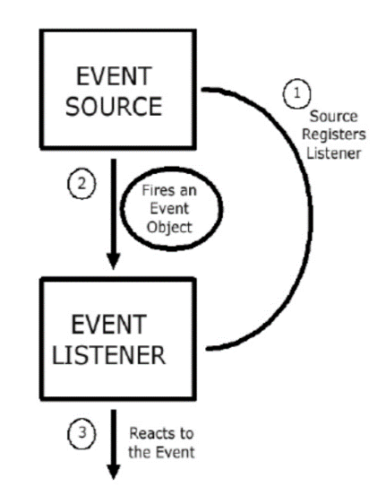
Introduction to Events, Events Handling
Functions of Event Handling
Event Handling identifies where an event should be forwarded.
It makes the forward event.
It receives the forwarded event.
It takes some kind of appropriate action in response, such as writing to a log, sending an error or recovery routine or sending a message.
The event handler may ultimately forward the event to an event consumer.
Notes:
This slide talks about the case if we have to divide a subtopic further.
Title Box - Parent Topic
Subtitle box - Sub Topic
Body Text - Subtopic divisions (Subtopics of subtopics)

Slide 8
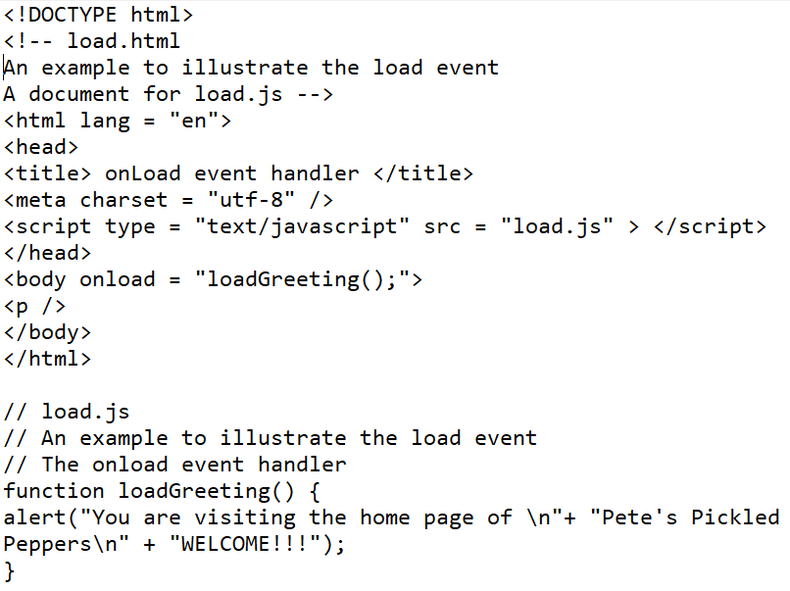
Introduction to Events, Events Handling
Javascript Events
onclick - Occurs when the user clicks on a link or form element
onload - Occurs when a page is loaded into the browser (i.e., opened)
onsubmit - Occurs when a form's Submit button is clicked
onfocus - Occurs when a user gives input or focus to a form element
Onload event
Notes:
This slide talks about the case if we have to divide a subtopic further.
Title Box - Parent Topic
Subtitle box - Sub Topic
Body Text - Subtopic divisions (Subtopics of subtopics)

Slide 9
Introduction to Exceptional Handling
Exceptional handling, Errors
Exception handling is one of the powerful JavaScript features to handle errors and maintain a regular JavaScript code/program flow.
Errors occur due to mistakes made by developers, wrong input, or unforeseeable things.
Image Source:
Notes:
Left (White Color space):
Title - Parent Topic
Subtitle - Subtopic 1
Body Text - Description in bullets
Right (Grey Color Space):
Body Text - Relevant image (with source)/code snippet
Put reference links in Speaker Notes
Reference:
https://www.tutorialspoint.com/internet_technologies/internet_overview.htm/

Slide 10
Introduction to Exceptional Handling
Reasons why exception occurs
Dividing a number by zero: This results in infinity, thus throwing an exception.
When a requested file does not exist in the system.
When the user provides the wrong input.
When the network drops during communication.
Image Source:
Notes:
Left (White Color space):
Title - Parent Topic
Subtitle - Subtopic 1
Body Text - Description in bullets
Right (Grey Color Space):
Body Text - Relevant image (with source)/code snippet
Put reference links in Speaker Notes
Reference:
https://www.tutorialspoint.com/internet_technologies/internet_overview.htm/

Slide 11
Introduction to Exceptional Handling
Error types
Syntax errors
Runtime errors
Logical errors
Image Source:
Notes:
Left (White Color space):
Title - Parent Topic
Subtitle - Subtopic 1
Body Text - Description in bullets
Right (Grey Color Space):
Body Text - Relevant image (with source)/code snippet
Put reference links in Speaker Notes
Reference:
https://www.tutorialspoint.com/internet_technologies/internet_overview.htm/

Slide 12
Introduction to Exceptional Handling
Error types
Syntax errors - These are errors that cannot be interpreted by the computer. These errors stop the program from working. These errors are:
Spelling errors (wrong spelling such as fiction instead of function).
The omission of important characters, such as not using a semicolon to end a statement.
Use of the wrong indentation.
Image Source:
Notes:
Left (White Color space):
Title - Parent Topic
Subtitle - Subtopic 1
Body Text - Description in bullets
Right (Grey Color Space):
Body Text - Relevant image (with source)/code snippet
Put reference links in Speaker Notes
Reference:
https://www.tutorialspoint.com/internet_technologies/internet_overview.htm/

Slide 13
Introduction to Exceptional Handling
Error types
Runtime errors - These errors take place during execution.
The errors get detected when your program runs.
It crashes or raises an exception. Thus, exception handlers handle exception errors.
Image Source:
Notes:
Left (White Color space):
Title - Parent Topic
Subtitle - Subtopic 1
Body Text - Description in bullets
Right (Grey Color Space):
Body Text - Relevant image (with source)/code snippet
Put reference links in Speaker Notes
Reference:
https://www.tutorialspoint.com/internet_technologies/internet_overview.htm/

Slide 14
Introduction to Exceptional Handling
Error types
Runtime errors - These errors are often caused by:
The program not being able to find data because it does not exist.
The data being an invalid type of data.
Image Source:
Notes:
Left (White Color space):
Title - Parent Topic
Subtitle - Subtopic 1
Body Text - Description in bullets
Right (Grey Color Space):
Body Text - Relevant image (with source)/code snippet
Put reference links in Speaker Notes
Reference:
https://www.tutorialspoint.com/internet_technologies/internet_overview.htm/

Slide 15
Introduction to Exceptional Handling
Error types
Logical Errors - These types of errors do not throw an error or an exception at all.
This is because they result from the code not doing what the developer intends it to.
It’s challenging to find logical errors.
They can only be found through thorough testing.
Image Source:
Notes:
Left (White Color space):
Title - Parent Topic
Subtitle - Subtopic 1
Body Text - Description in bullets
Right (Grey Color Space):
Body Text - Relevant image (with source)/code snippet
Put reference links in Speaker Notes
Reference:
https://www.tutorialspoint.com/internet_technologies/internet_overview.htm/

Slide 16
Introduction to Exceptional Handling
Error Objects
When a runtime error occurs, it stops the code and raises an error object.
The error object has two properties:
Name: It gives the error name.
Message: It sets or returns the error message in the form of a string.
Image Source:
Notes:
Left (White Color space):
Title - Parent Topic
Subtitle - Subtopic 1
Body Text - Description in bullets
Right (Grey Color Space):
Body Text - Relevant image (with source)/code snippet
Put reference links in Speaker Notes
Reference:
https://www.tutorialspoint.com/internet_technologies/internet_overview.htm/

Slide 17
Introduction to Exceptional Handling
Six types of Error Objects
EvalError: The EvalError function indicates the error that occurred in the eval() function.
It’s a global function that evaluates the JavaScript string.
RangeError: RangeError exceptions occur when a numeric value is outside the specified range.
Image Source:
Notes:
Left (White Color space):
Title - Parent Topic
Subtitle - Subtopic 1
Body Text - Description in bullets
Right (Grey Color Space):
Body Text - Relevant image (with source)/code snippet
Put reference links in Speaker Notes
Reference:
https://www.tutorialspoint.com/internet_technologies/internet_overview.htm/

Slide 18
Introduction to Exceptional Handling
Six types of Error Objects
ReferenceError: A ReferenceError exception occurs when undeclared variables are used.
These exceptions commonly occur due to spelling errors on variables.
Syntax Error: A Syntax Error exception occurs when JavaScript language rules get broken.
Image Source:
Notes:
Left (White Color space):
Title - Parent Topic
Subtitle - Subtopic 1
Body Text - Description in bullets
Right (Grey Color Space):
Body Text - Relevant image (with source)/code snippet
Put reference links in Speaker Notes
Reference:
https://www.tutorialspoint.com/internet_technologies/internet_overview.htm/

Slide 19
Introduction to Exceptional Handling
Six types of Error Objects
TypeError: A TypeError exception occurs when a value is different from the one expected.
URIError: A URIError exception is raised by encodeURI() and decodeURI() methods.
Image Source:
Notes:
Left (White Color space):
Title - Parent Topic
Subtitle - Subtopic 1
Body Text - Description in bullets
Right (Grey Color Space):
Body Text - Relevant image (with source)/code snippet
Put reference links in Speaker Notes
Reference:
https://www.tutorialspoint.com/internet_technologies/internet_overview.htm/

Slide 20
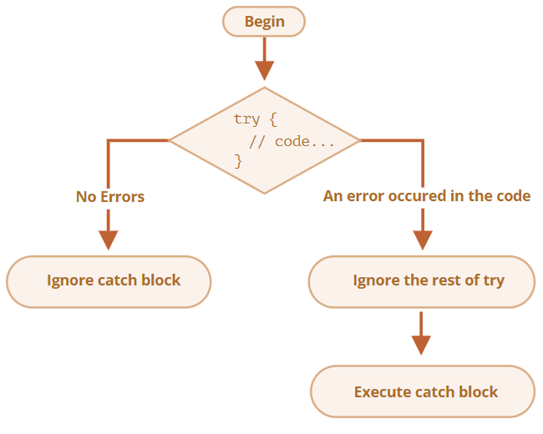
Introduction to Exceptional Handling
Exceptional Handling
A try-catch-finally statement is a code or program that handles exceptions.
The try clause runs the code that generates exceptions.
The catch clause catches exceptions that are thrown.
A finally clause always gets executed.
The throw statement generates exceptions.
Image Source:
Notes:
Left (White Color space):
Title - Parent Topic
Subtitle - Subtopic 1
Body Text - Description in bullets
Right (Grey Color Space):
Body Text - Relevant image (with source)/code snippet
Put reference links in Speaker Notes
Reference:
https://www.tutorialspoint.com/internet_technologies/internet_overview.htm/

Slide 21
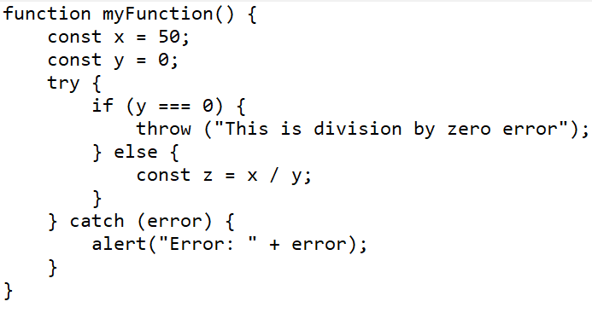
Introduction to Exceptional Handling
Exceptional Handling
Throw statements - The throw statement is to raise your built-in exceptions.
Image Source:
Notes:
Left (White Color space):
Title - Parent Topic
Subtitle - Subtopic 1
Body Text - Description in bullets
Right (Grey Color Space):
Body Text - Relevant image (with source)/code snippet
Put reference links in Speaker Notes
Reference:
https://www.tutorialspoint.com/internet_technologies/internet_overview.htm/

Slide 22
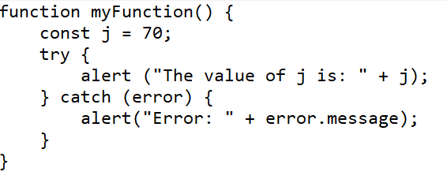
Introduction to Exceptional Handling
Exceptional Handling
Try catch statements - The try clause has the main code that may generate exceptions.
If an exception is raised, the catch clause gets executed.
Image Source:
Notes:
Left (White Color space):
Title - Parent Topic
Subtitle - Subtopic 1
Body Text - Description in bullets
Right (Grey Color Space):
Body Text - Relevant image (with source)/code snippet
Put reference links in Speaker Notes
Reference:
https://www.tutorialspoint.com/internet_technologies/internet_overview.htm/

Slide 23
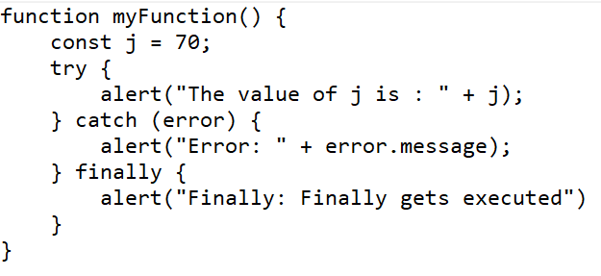
Introduction to Exceptional Handling
Exceptional Handling
Try catch finally statements - The finally statement is the last block to be executed.
It executes after try and catch clauses.
Image Source:
Notes:
Left (White Color space):
Title - Parent Topic
Subtitle - Subtopic 1
Body Text - Description in bullets
Right (Grey Color Space):
Body Text - Relevant image (with source)/code snippet
Put reference links in Speaker Notes
Reference:
https://www.tutorialspoint.com/internet_technologies/internet_overview.htm/

Slide 24
Introduction to Browser Object Model
Browser Object Model
The browser object model (BOM) is a hierarchy of browser objects that are used to manipulate methods and properties associated with the Web browser itself.
Image Source:
Notes:
Left (White Color space):
Title - Parent Topic
Subtitle - Subtopic 1
Body Text - Description in bullets
Right (Grey Color Space):
Body Text - Relevant image (with source)/code snippet
Put reference links in Speaker Notes
Reference:
https://www.tutorialspoint.com/internet_technologies/internet_overview.htm/

Slide 25
Introduction to Browser Object Model
Browser Object Model
The Document Object consists of objects that are used to manipulate methods and properties of the document or Web page loaded in the browser window.
The document object represents the Web page currently loaded in the browser window.
Image Source:
Notes:
Left (White Color space):
Title - Parent Topic
Subtitle - Subtopic 1
Body Text - Description in bullets
Right (Grey Color Space):
Body Text - Relevant image (with source)/code snippet
Put reference links in Speaker Notes
Reference:
https://www.tutorialspoint.com/internet_technologies/internet_overview.htm/

Slide 26
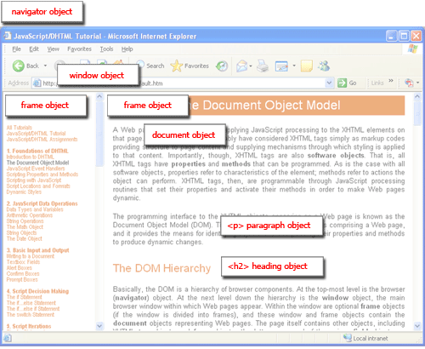
Introduction to Browser Object Model
The BOM Hierarchy
The top-level object in the BOM is the window object.
The window object represents the browser window.
The window object includes a number of properties and methods that can be used to control the Web browser.
Image Source:
Notes:
Left (White Color space):
Title - Parent Topic
Subtitle - Subtopic 1
Body Text - Description in bullets
Right (Grey Color Space):
Body Text - Relevant image (with source)/code snippet
Put reference links in Speaker Notes
Reference:
https://www.tutorialspoint.com/internet_technologies/internet_overview.htm/

Slide 27
Introduction to Browser Object Model
The BOM Hierarchy
The screen object, that contains information about the visitor's screen.
The history object, that is part of the window object and contains the URLs that have been visited by the user.
The location object that contains information about the current URL.
Image Source:
Notes:
Left (White Color space):
Title - Parent Topic
Subtitle - Subtopic 1
Body Text - Description in bullets
Right (Grey Color Space):
Body Text - Relevant image (with source)/code snippet
Put reference links in Speaker Notes
Reference:
https://www.tutorialspoint.com/internet_technologies/internet_overview.htm/

Slide 28
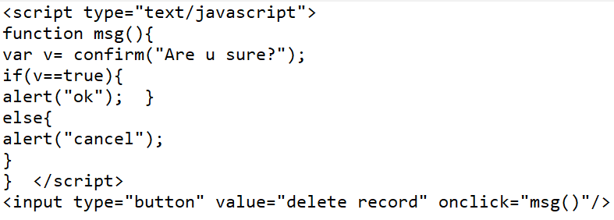
Introduction to Browser Object Model
Window Object Method
window.alert() - Creates dialog box with message and an OK button
window.blur() - Remove focus from window
window.close() - Closes a browser window
window.confirm() - Creates dialog box with message, an OK button and a cancel button
Image Source:
Notes:
Left (White Color space):
Title - Parent Topic
Subtitle - Subtopic 1
Body Text - Description in bullets
Right (Grey Color Space):
Body Text - Relevant image (with source)/code snippet
Put reference links in Speaker Notes
Reference:
https://www.tutorialspoint.com/internet_technologies/internet_overview.htm/

Slide 29
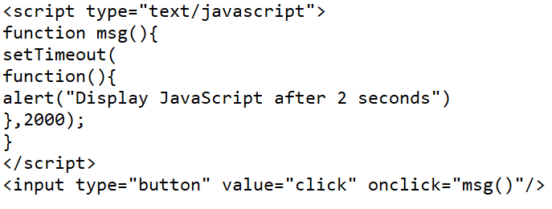
Introduction to Browser Object Model
Window Object Method
window.prompt() - Creates dialog box for retrieving user input
window.setInterval() - Do something repeatedly at specified intervals
window.setTimeout() - Do something after a specified amount of time
Image Source:
Notes:
Left (White Color space):
Title - Parent Topic
Subtitle - Subtopic 1
Body Text - Description in bullets
Right (Grey Color Space):
Body Text - Relevant image (with source)/code snippet
Put reference links in Speaker Notes
Reference:
https://www.tutorialspoint.com/internet_technologies/internet_overview.htm/

Slide 30
Introduction to Browser Object Model
Window Object Property
window.closed - Whether the window has been closed
window.length - Number of <iframe> elements in window
window.name - Gets or sets the name of the window
window.innerHeight - Height of window
window.innerWidth - Width of window
Image Source:
Notes:
Left (White Color space):
Title - Parent Topic
Subtitle - Subtopic 1
Body Text - Description in bullets
Right (Grey Color Space):
Body Text - Relevant image (with source)/code snippet
Put reference links in Speaker Notes
Reference:
https://www.tutorialspoint.com/internet_technologies/internet_overview.htm/

Slide 31
Introduction to Browser Object Model
Window Object Property
window.screen – X - coordinate of pointer, relative to top left corner of screen
window.screen – Y - coordinate of pointer, relative to top left corner of screen
window.location - Current URL of window object (or local file path)
window.history - Reference to history object for browser window or tab.
Image Source:
Notes:
Left (White Color space):
Title - Parent Topic
Subtitle - Subtopic 1
Body Text - Description in bullets
Right (Grey Color Space):
Body Text - Relevant image (with source)/code snippet
Put reference links in Speaker Notes
Reference:
https://www.tutorialspoint.com/internet_technologies/internet_overview.htm/

Slide 32
Introduction to Browser Object Model
Window Object Property
window.screen - Reference to screen object
window.pageXOffset - Distance document has been scrolled horizontally
window.pageYOffset - Distance document has been scrolled vertically
Image Source:
Notes:
Left (White Color space):
Title - Parent Topic
Subtitle - Subtopic 1
Body Text - Description in bullets
Right (Grey Color Space):
Body Text - Relevant image (with source)/code snippet
Put reference links in Speaker Notes
Reference:
https://www.tutorialspoint.com/internet_technologies/internet_overview.htm/

Slide 33
Introduction to Browser Object Model
Navigator Object
The JavaScript navigator object is used for browser detection.
The navigator object is the window property, so it can be accessed by: window.navigator Or, navigator
Image Source:
Notes:
Left (White Color space):
Title - Parent Topic
Subtitle - Subtopic 1
Body Text - Description in bullets
Right (Grey Color Space):
Body Text - Relevant image (with source)/code snippet
Put reference links in Speaker Notes
Reference:
https://www.tutorialspoint.com/internet_technologies/internet_overview.htm/

Slide 34
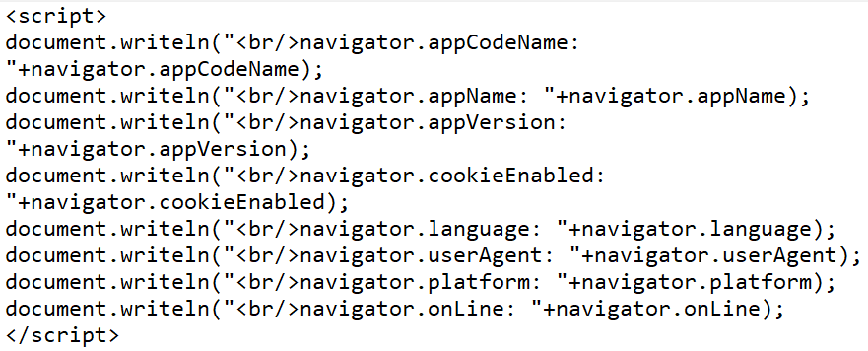
Introduction to Browser Object Model
Navigator Object Method
javaEnabled() - checks if java is enabled.
taintEnabled() - checks if taint is enabled. It is deprecated since JavaScript 1.2.
Image Source:
Notes:
Left (White Color space):
Title - Parent Topic
Subtitle - Subtopic 1
Body Text - Description in bullets
Right (Grey Color Space):
Body Text - Relevant image (with source)/code snippet
Put reference links in Speaker Notes
Reference:
https://www.tutorialspoint.com/internet_technologies/internet_overview.htm/

Slide 35
Introduction to Browser Object Model
Navigator Object Property
appName - returns the name
appVersion - returns the version
appCodeName - returns the code name
cookieEnabled - returns true if cookie is enabled otherwise false
userAgent - returns the user agent
Language - returns the language. It is supported in Netscape and Firefox only.
Image Source:
Notes:
Left (White Color space):
Title - Parent Topic
Subtitle - Subtopic 1
Body Text - Description in bullets
Right (Grey Color Space):
Body Text - Relevant image (with source)/code snippet
Put reference links in Speaker Notes
Reference:
https://www.tutorialspoint.com/internet_technologies/internet_overview.htm/

Slide 36
Introduction to Browser Object Model
Screen Object
The Screen object provides the attributes of the screen on which the current window is being rendered.
The Screen object is typically used by the web analytic software like Google Analytics to collect information of the client device on which the web browsers are running.
Image Source:
Notes:
Left (White Color space):
Title - Parent Topic
Subtitle - Subtopic 1
Body Text - Description in bullets
Right (Grey Color Space):
Body Text - Relevant image (with source)/code snippet
Put reference links in Speaker Notes
Reference:
https://www.tutorialspoint.com/internet_technologies/internet_overview.htm/

Slide 37
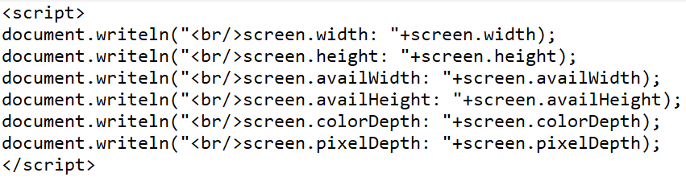
Introduction to Browser Object Model
Screen Object Property
Width - returns the width of the screen
Height - returns the height of the screen
availWidth - returns the available width
availHeight - returns the available height
colorDepth - returns the color depth
pixelDepth - returns the pixel depth.
Image Source:
Notes:
Left (White Color space):
Title - Parent Topic
Subtitle - Subtopic 1
Body Text - Description in bullets
Right (Grey Color Space):
Body Text - Relevant image (with source)/code snippet
Put reference links in Speaker Notes
Reference:
https://www.tutorialspoint.com/internet_technologies/internet_overview.htm/

Slide 38
Introduction to Browser Object Model
setTimeout() method
The setTimeout() method in JavaScript is used to execute a function after waiting for the specified time interval.
This method returns a numeric value that represents the ID value of the timer.
The setTimeout() method executes the function only once. This method can be written with or without the window prefix.
Image Source:
Notes:
Left (White Color space):
Title - Parent Topic
Subtitle - Subtopic 1
Body Text - Description in bullets
Right (Grey Color Space):
Body Text - Relevant image (with source)/code snippet
Put reference links in Speaker Notes
Reference:
https://www.tutorialspoint.com/internet_technologies/internet_overview.htm/

Slide 39
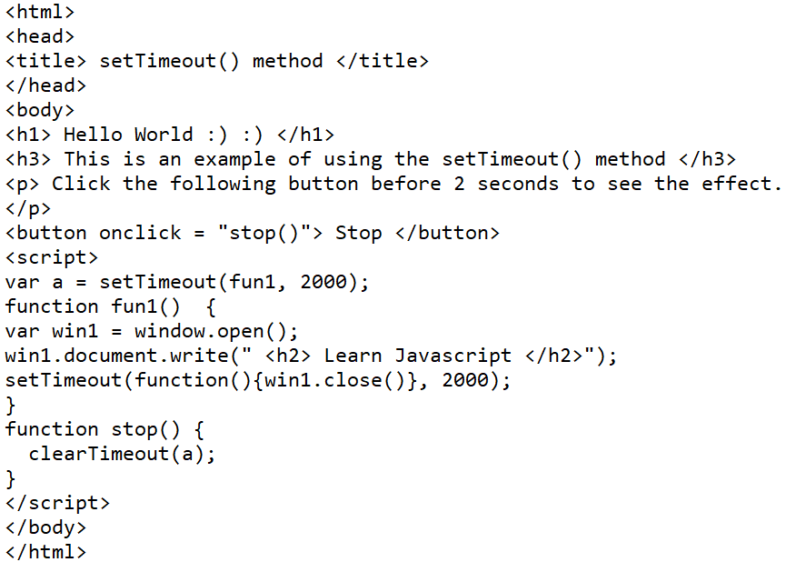
Introduction to Browser Object Model
setTimeout() method
Syntax- window.setTimeout(function, milliseconds);
function: It is the function containing the block of code that will be executed.
milliseconds: This parameter represents the time-interval after which the execution of the function takes place.
Image Source:
Notes:
Left (White Color space):
Title - Parent Topic
Subtitle - Subtopic 1
Body Text - Description in bullets
Right (Grey Color Space):
Body Text - Relevant image (with source)/code snippet
Put reference links in Speaker Notes
Reference:
https://www.tutorialspoint.com/internet_technologies/internet_overview.htm/

Slide 40
Introduction to Browser Object Model
setInterval() method
The setInterval() method in JavaScript is used to repeat a specified function at every given time-interval.
The setInterval() method in JavaScript is used to repeat a specified function at every given time-interval.
Image Source:
Notes:
Left (White Color space):
Title - Parent Topic
Subtitle - Subtopic 1
Body Text - Description in bullets
Right (Grey Color Space):
Body Text - Relevant image (with source)/code snippet
Put reference links in Speaker Notes
Reference:
https://www.tutorialspoint.com/internet_technologies/internet_overview.htm/

Slide 41
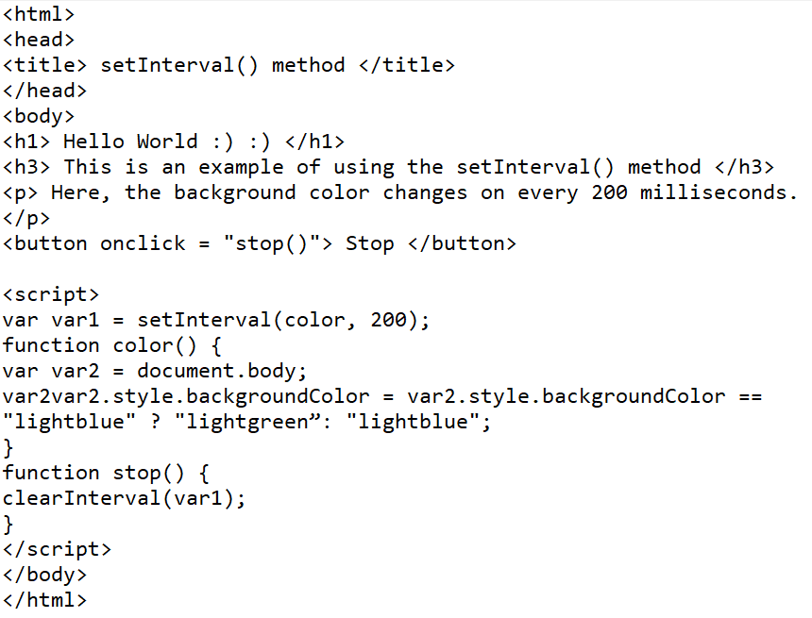
Introduction to Browser Object Model
setInterval() method
Syntax - window.setInterval(function, milliseconds);
function: It is the function containing the block of code that will be executed.
milliseconds: This parameter represents the length of the time interval between each execution
Image Source:
Notes:
Left (White Color space):
Title - Parent Topic
Subtitle - Subtopic 1
Body Text - Description in bullets
Right (Grey Color Space):
Body Text - Relevant image (with source)/code snippet
Put reference links in Speaker Notes
Reference:
https://www.tutorialspoint.com/internet_technologies/internet_overview.htm/

Slide 42
Introduction to Browser Object Model
setInterval() method
Syntax - window.setInterval(function, milliseconds);
function: It is the function containing the block of code that will be executed.
milliseconds: This parameter represents the length of the time interval between each execution
Image Source:
Notes:
Left (White Color space):
Title - Parent Topic
Subtitle - Subtopic 1
Body Text - Description in bullets
Right (Grey Color Space):
Body Text - Relevant image (with source)/code snippet
Put reference links in Speaker Notes
Reference:
https://www.tutorialspoint.com/internet_technologies/internet_overview.htm/

Slide 43
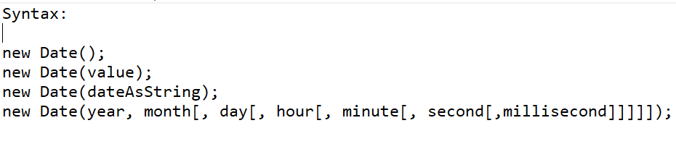
JavaScript Date
Date
The JavaScript date object can be used to get year, month and day.
You can display a timer on the webpage by the help of JavaScript date object.
Image Source:
Notes:
Left (White Color space):
Title - Parent Topic
Subtitle - Subtopic 1
Body Text - Description in bullets
Right (Grey Color Space):
Body Text - Relevant image (with source)/code snippet
Put reference links in Speaker Notes
Reference:
https://www.tutorialspoint.com/internet_technologies/internet_overview.htm/

Slide 44
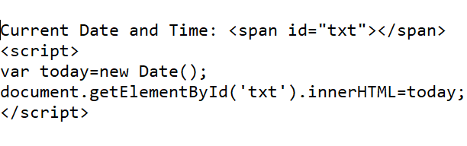
JavaScript Date
Date Methods
getDate() - It returns the integer value between 1 and 31 that represents the day for the specified date on the basis of local time.
getDay() - It returns the integer value between 0 and 6 that represents the day of the week on the basis of local time.
setDate() - It sets the day value for the specified date on the basis of local time.
Image Source:
Notes:
Left (White Color space):
Title - Parent Topic
Subtitle - Subtopic 1
Body Text - Description in bullets
Right (Grey Color Space):
Body Text - Relevant image (with source)/code snippet
Put reference links in Speaker Notes
Reference:
https://www.tutorialspoint.com/internet_technologies/internet_overview.htm/

Slide 45
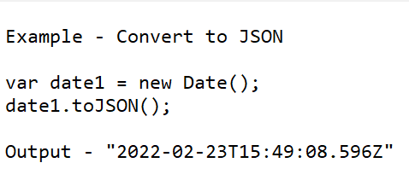
JavaScript Date
Date Methods
toJSON() - It returns a string representing the Date object. It also serializes the Date object during JSON serialization.
toString() - It returns the date in the form of string.
toTimeString() - It returns the time portion of a Date object.
valueOf() - It returns the primitive value of a Date object.
Image Source:
Notes:
Left (White Color space):
Title - Parent Topic
Subtitle - Subtopic 1
Body Text - Description in bullets
Right (Grey Color Space):
Body Text - Relevant image (with source)/code snippet
Put reference links in Speaker Notes
Reference:
https://www.tutorialspoint.com/internet_technologies/internet_overview.htm/

Slide 46
Introduction to Ajax
Ajax
Ajax stands for Asynchronous JavaScript And Xml.
Ajax is just a means of loading data from the server and selectively updating parts of a web page without reloading the whole page.
Image Source:
Notes:
Left (White Color space):
Title - Parent Topic
Subtitle - Subtopic 1
Body Text - Description in bullets
Right (Grey Color Space):
Body Text - Relevant image (with source)/code snippet
Put reference links in Speaker Notes
Reference:
https://www.tutorialspoint.com/internet_technologies/internet_overview.htm/

Slide 47
Introduction to Ajax
Ajax Applications Example
Example of some large-scale Ajax-driven online applications are: Gmail, Google Maps, Google Docs, YouTube, Facebook, Flickr, and so many other applications.
Image Source:
Notes:
Left (White Color space):
Title - Parent Topic
Subtitle - Subtopic 1
Body Text - Description in bullets
Right (Grey Color Space):
Body Text - Relevant image (with source)/code snippet
Put reference links in Speaker Notes
Reference:
https://www.tutorialspoint.com/internet_technologies/internet_overview.htm/

Slide 48
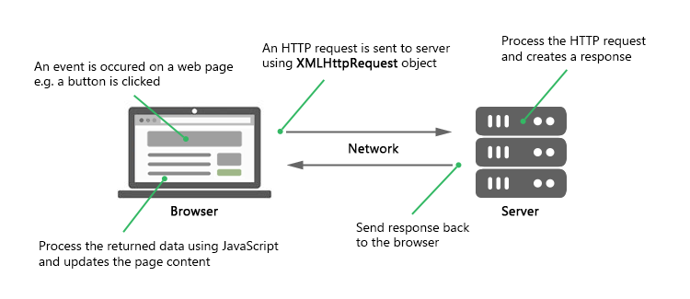
Introduction to Ajax
How Ajax Works
To perform Ajax communication JavaScript uses a special object built into the browser—an XMLHttpRequest (XHR) object—to make HTTP requests to the server and receive data in response.
Image Source:
Notes:
Left (White Color space):
Title - Parent Topic
Subtitle - Subtopic 1
Body Text - Description in bullets
Right (Grey Color Space):
Body Text - Relevant image (with source)/code snippet
Put reference links in Speaker Notes
Reference:
https://www.tutorialspoint.com/internet_technologies/internet_overview.htm/

Slide 49
Introduction to Ajax
Sending Request and Retrieving the Response
The first thing you must do is to instantiate an XMLHttpRequest object, as shown below:
var request = new XMLHttpRequest();
Image Source:
Notes:
Left (White Color space):
Title - Parent Topic
Subtitle - Subtopic 1
Body Text - Description in bullets
Right (Grey Color Space):
Body Text - Relevant image (with source)/code snippet
Put reference links in Speaker Notes
Reference:
https://www.tutorialspoint.com/internet_technologies/internet_overview.htm/

Slide 50
Introduction to Ajax
Sending Request and Retrieving the Response
The next step in sending the request to the server is to instantiating the newly-created request object using the open() method of the XMLHttpRequest object.
request.open("GET", "info.txt"); -Or- request.open("POST", "add-user.php");
Image Source:
Notes:
Left (White Color space):
Title - Parent Topic
Subtitle - Subtopic 1
Body Text - Description in bullets
Right (Grey Color Space):
Body Text - Relevant image (with source)/code snippet
Put reference links in Speaker Notes
Reference:
https://www.tutorialspoint.com/internet_technologies/internet_overview.htm/

Slide 51
Introduction to Ajax
Sending Request and Retrieving the Response
Finally send the request to the server using the send() method of the XMLHttpRequest object.
request.send(); -Or- request.send(body);
Image Source:
Notes:
Left (White Color space):
Title - Parent Topic
Subtitle - Subtopic 1
Body Text - Description in bullets
Right (Grey Color Space):
Body Text - Relevant image (with source)/code snippet
Put reference links in Speaker Notes
Reference:
https://www.tutorialspoint.com/internet_technologies/internet_overview.htm/

Slide 52
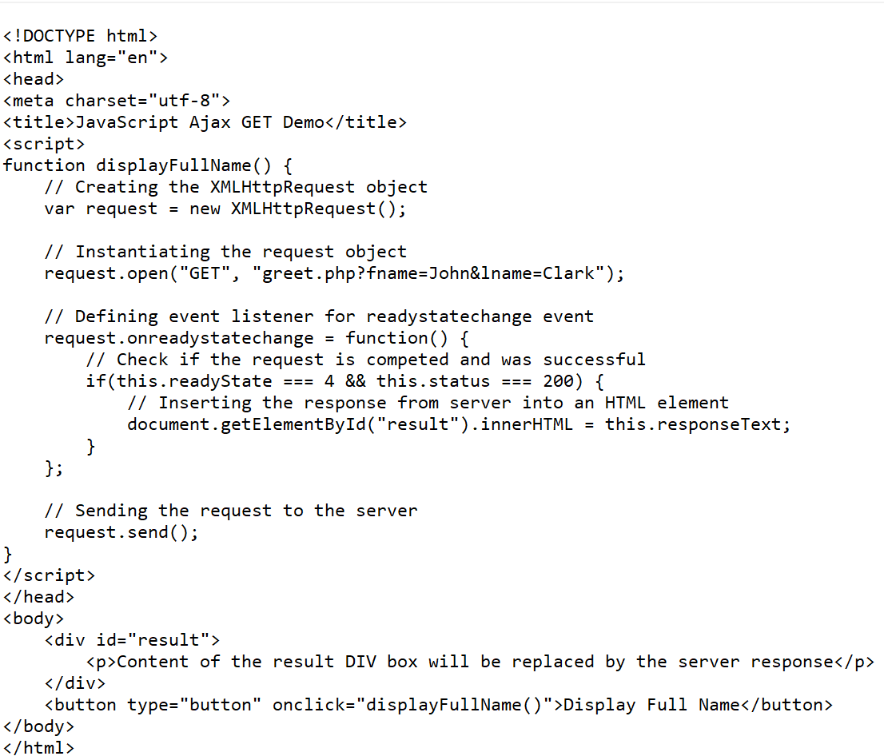
Introduction to Ajax
Performing an Ajax GET Request
The GET request is typically used to get or retrieve some kind of information from the server that doesn't require any manipulation or change in database
Image Source:
Notes:
Left (White Color space):
Title - Parent Topic
Subtitle - Subtopic 1
Body Text - Description in bullets
Right (Grey Color Space):
Body Text - Relevant image (with source)/code snippet
Put reference links in Speaker Notes
Reference:
https://www.tutorialspoint.com/internet_technologies/internet_overview.htm/

Slide 53
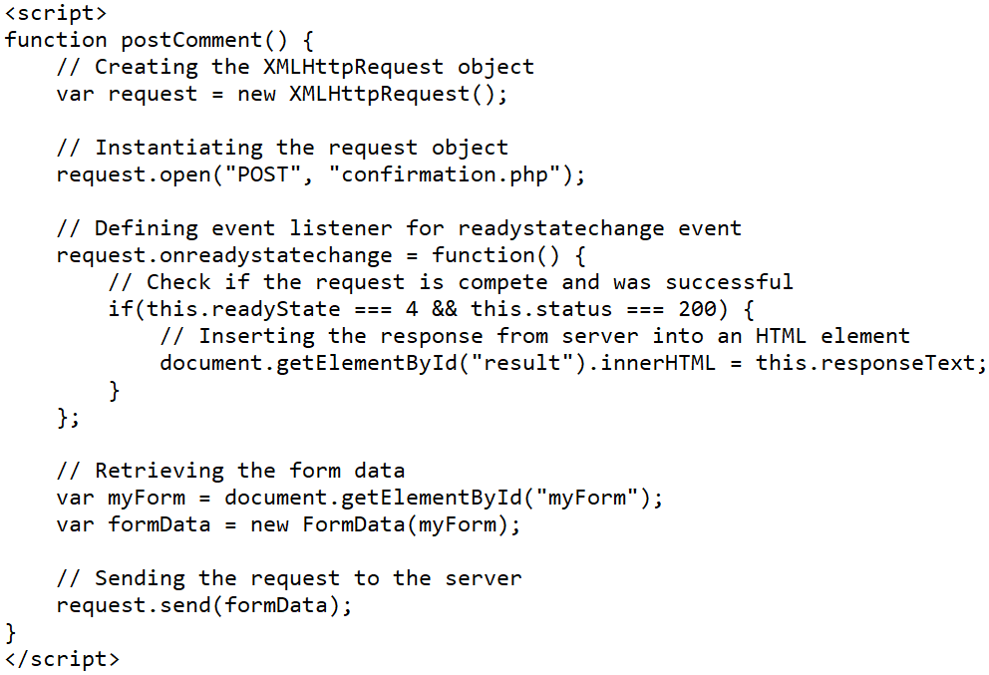
Introduction to Ajax
Performing an Ajax POST Request
The POST method is mainly used to submit a form data to the web server.
Image Source:
Notes:
Left (White Color space):
Title - Parent Topic
Subtitle - Subtopic 1
Body Text - Description in bullets
Right (Grey Color Space):
Body Text - Relevant image (with source)/code snippet
Put reference links in Speaker Notes
Reference:
https://www.tutorialspoint.com/internet_technologies/internet_overview.htm/

Slide 54
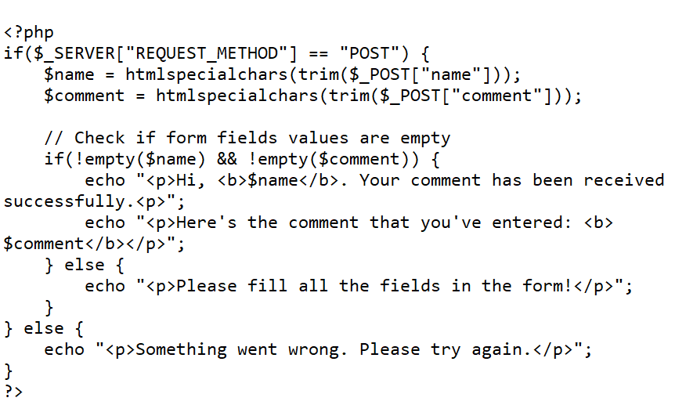
Introduction to Ajax
Performing an Ajax POST Request
Explicitly set the request header using setRequestHeader() method
request.setRequestHeader("Content-type", "application/x-www-form-urlencoded");
The setRequestHeader() method, must be called after calling open(), but before calling send().
Image Source:
Notes:
Left (White Color space):
Title - Parent Topic
Subtitle - Subtopic 1
Body Text - Description in bullets
Right (Grey Color Space):
Body Text - Relevant image (with source)/code snippet
Put reference links in Speaker Notes
Reference:
https://www.tutorialspoint.com/internet_technologies/internet_overview.htm/

Slide 55
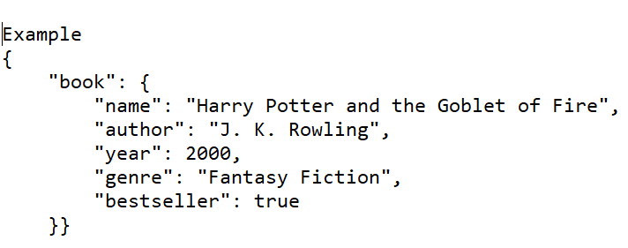
Introduction to JSON
JSON
JSON stands for JavaScript Object Notation.
JSON is extremely lightweight data-interchange format for data exchange between server and client.
Image Source:
Notes:
Left (White Color space):
Title - Parent Topic
Subtitle - Subtopic 1
Body Text - Description in bullets
Right (Grey Color Space):
Body Text - Relevant image (with source)/code snippet
Put reference links in Speaker Notes
Reference:
https://www.tutorialspoint.com/internet_technologies/internet_overview.htm/

Slide 56
Introduction to JSON
JSON
JSON is based on two basic structures:
Object: This is defined as an unordered collection of key/value pairs (i.e. key:value).
Each object begins with a left curly bracket { and ends with a right curly bracket }.
Multiple key/value pairs are separated by a comma ,.
Image Source:
Notes:
Left (White Color space):
Title - Parent Topic
Subtitle - Subtopic 1
Body Text - Description in bullets
Right (Grey Color Space):
Body Text - Relevant image (with source)/code snippet
Put reference links in Speaker Notes
Reference:
https://www.tutorialspoint.com/internet_technologies/internet_overview.htm/

Slide 57
Introduction to JSON
JSON
Array: This is defined as an ordered list of values.
An array begins with a left bracket [ and ends with a right bracket ].
Values are separated by a comma ,.
Image Source:
Notes:
Left (White Color space):
Title - Parent Topic
Subtitle - Subtopic 1
Body Text - Description in bullets
Right (Grey Color Space):
Body Text - Relevant image (with source)/code snippet
Put reference links in Speaker Notes
Reference:
https://www.tutorialspoint.com/internet_technologies/internet_overview.htm/

Slide 58
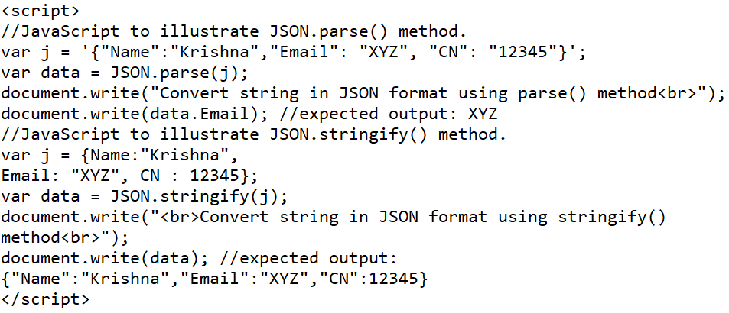
Introduction to JSON
JSON Methods
JSON.parse() - This method takes a JSON string and transforms it into a JavaScript object.
JSON.stringify() - This method converts a JavaScript value (JSON object) to a JSON string representation.
Image Source:
Notes:
Left (White Color space):
Title - Parent Topic
Subtitle - Subtopic 1
Body Text - Description in bullets
Right (Grey Color Space):
Body Text - Relevant image (with source)/code snippet
Put reference links in Speaker Notes
Reference:
https://www.tutorialspoint.com/internet_technologies/internet_overview.htm/

Slide 59
References
https://www.section.io/engineering-education/exception-handling-in-javascript/
https://itwebtutorials.mga.edu/js/chp1/browser-object-model.aspx
https://riptutorial.com/javascript
https://www.javatpoint.com/javascript-tutorial
Image Source:
Notes:
Left (White Color space):
Title - Parent Topic
Subtitle - Subtopic 1
Body Text - Description in bullets
Right (Grey Color Space):
Body Text - Relevant image (with source)/code snippet
Put reference links in Speaker Notes
Reference:
https://www.tutorialspoint.com/internet_technologies/internet_overview.htm/

